Slide 1
Instant Nerf - NVIDIA
-Vignesh Kannaa Loganathan

Slide 2
Abstract
Converting 2D images to a 3D scene instantly
Applications
Video games
Simulation
Virtual reality
Architecture design
Movies/ Animations
Ecommerce

Slide 3
Key Idea
To Reduce cost of fully connected Neural network
Convert to small neural network without reducing the quality
A small neural network is augmented by a multiresolution hash table of trainable feature vectors whose values are optimized through stochastic gradient descent

Slide 4
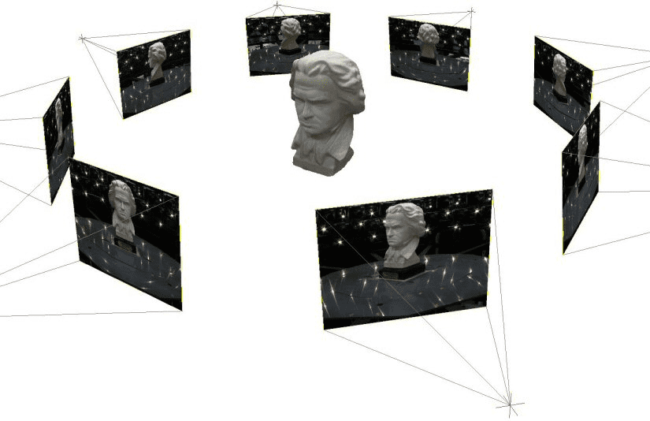
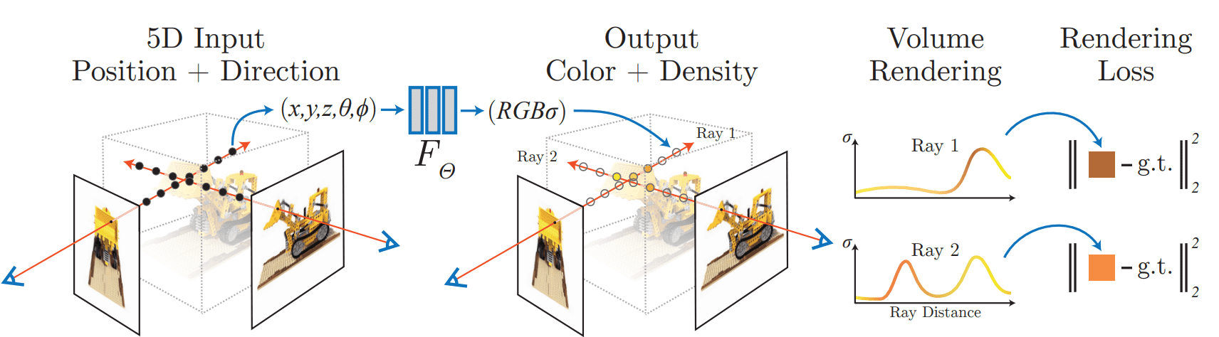
Previous Papers/ Methods
Neural Radiance Fields (2020)
Volume rendering

Slide 5
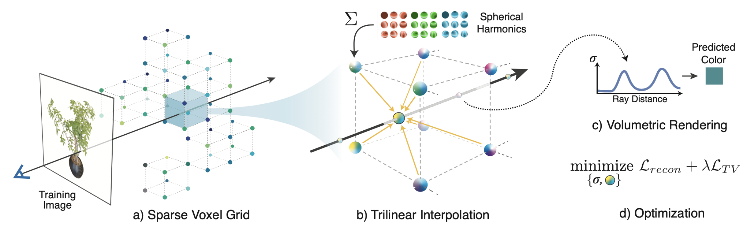
Previous Papers/ Methods - Cont.
2. Plenoxels (2021)
Radiance Fields without Neural Networks

Slide 6
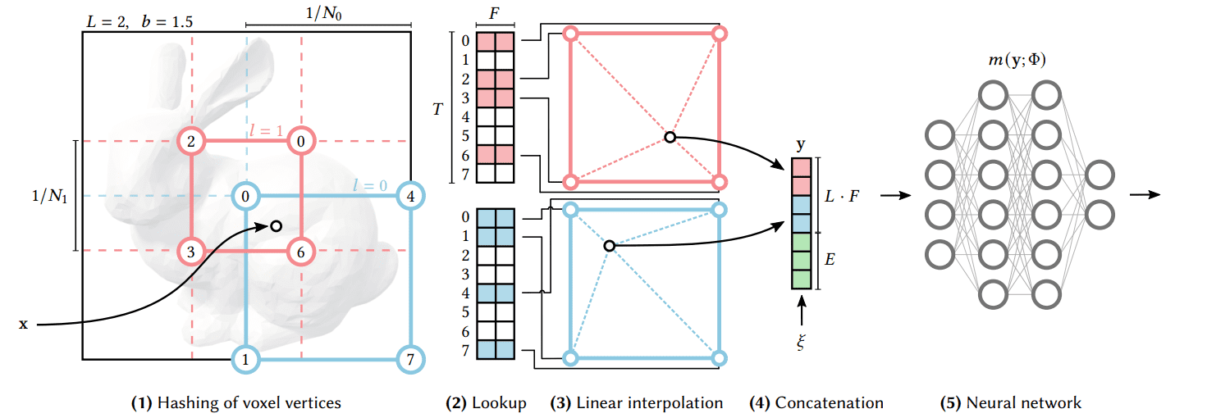
Contextual analysis
Multi-Resolution Hash Grid Encoding

Slide 7
Results
Hours
Minutes
Seconds

Slide 8
Results - Cont
Gigapixel Image
Signed Distance Function

Slide 9
References
https://nvlabs.github.io/instant-ngp/
https://alexyu.net/plenoxels/
https://www.matthewtancik.com/nerf

